Slide 1
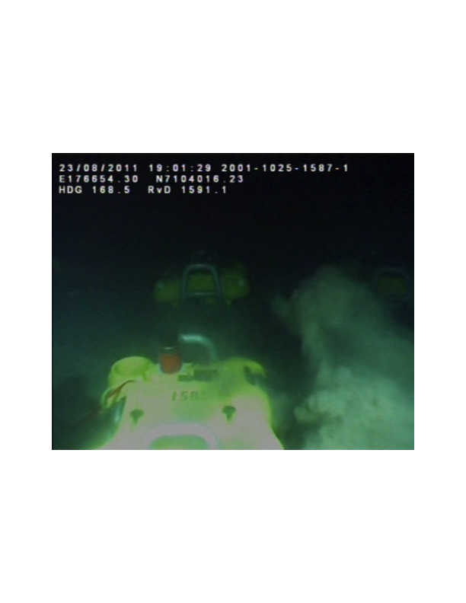
Seismic acquisition – ocean-bottom nodes

Slide 2
Seismic acquisition – multicomponent data
Pressure (hydrophone)
Particle velocities (geophones)
Vertical
Horizontal

Slide 3

Seismic acquisition – comparing vertical velocities
Difference Elastic Acoustic

Slide 4

Seismic acquisition – comparing horizontal velocities
Difference Elastic Acoustic

